Slide 1
Sleep expert

Slide 2
The background to the problem that the project was trying to solve;
Insomnia is a common problem that affects approximately one in three people in the UK, particularly the elderly. It is characterized by difficulty falling or staying asleep, resulting in daytime sleepiness, mood changes, and other negative effects.
Consistently staying up late or having trouble falling asleep can lead to daytime sleepiness, lethargy, mood changes, irritability, anxiety, and may contribute to the development of chronic diseases such as obesity, diabetes, and depression.

Slide 3
methods used for analysing the requirements
Competitor Analysis: Analyzing existing sleep applications in the market to identify their strengths and weaknesses, and to determine the gaps that the new application could fill.
methods or tools used for
Android Studio: Android Studio is the official integrated development environment (IDE) for Android app development. It provides a range of tools, such as a visual layout editor, a code editor, and a debugging tool, to help developers create Android apps.

Slide 4
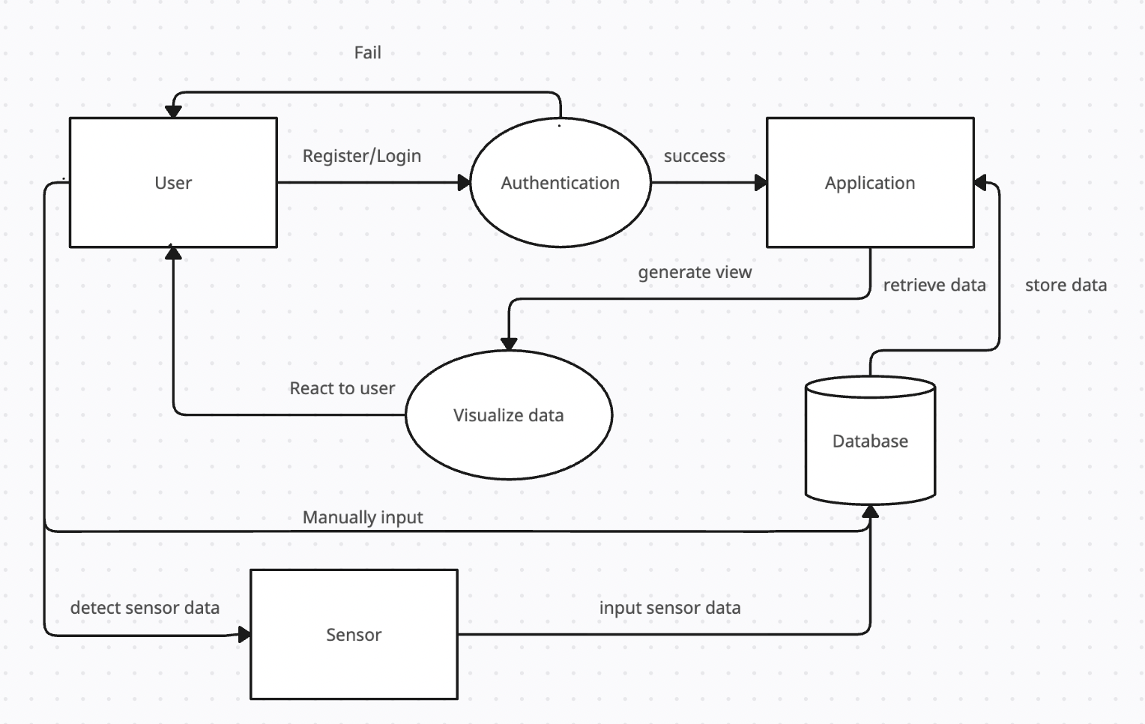
designing

Slide 5
implementation
implementing sleep tracking features: The sleep tracking feature was implemented using a combination of environment sensors such as humidity, temperature, and lightness, and motion sensors to detect body movement during sleep.
Integrating weather forecast and sleep tips: The app was integrated with weather forecast data to provide users with information about how weather conditions may affect their sleep quality. Sleep tips were also included to provide users with helpful suggestions for improving their sleep habits.
Implementing meditation feature: A meditation feature was added to provide users with guided meditation sessions to help them relax and fall asleep more easily.
Developing the alarm and reminder functions: The alarm and reminder functions were developed to allow users to set reminders for bedtime, wake-up time, and medication schedules.

Slide 6
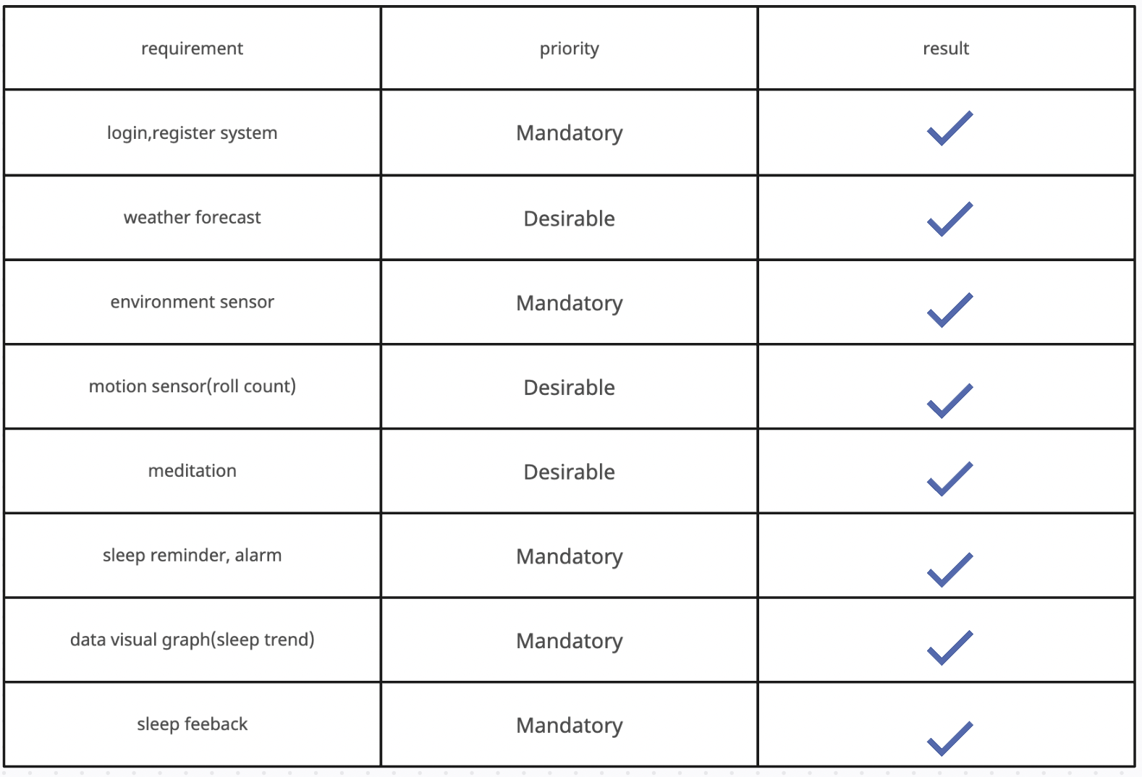
requirements were met

Slide 7
testing
Functional testing: This method is employed to verify that the essential requirements have been met. The functional requirements that were considered critical and necessary for the project are classified as "Mandatory" and have been marked in last page.
User testing: During user testing, several participants will combine their experiences to provide feedback on their favourite and least favourite features, areas that need improvement, as well as suggestions and feedback.

Slide 8
Any conclusions that can be drawn from the project.
Using environment sensors to track room conditions can enhance the user's sleeping experience.
Alarm and sleep reminders can help establish and maintain a regular sleep schedule, leading to better quality sleep.
The meditation feature can help users relax and fall asleep more easily.
The sleep application has the potential to greatly benefit users in improving their sleep quality and habits.

